Slide 1
Burnfoot Bids together
Jan Pringle, Burnfoot Community Futures Manager

Slide 2
Scheme outline
£30,000 Community Choices Fund
£4,500 Healthy Living Network
Information evening to gather community members End October
Community Led (Grass Roots)
Information Evening for Community 6th December
9 Initial Steering Group Members

Slide 3
Steering group tasks
Design our application process
Develop publicity & promote – to who, where, how, what and when
Process and sift if needed all the applications received
Plan and organise the voting day
Keep track on what’s been done by successful projects
Help to report/publicise what has been achieved

Slide 4
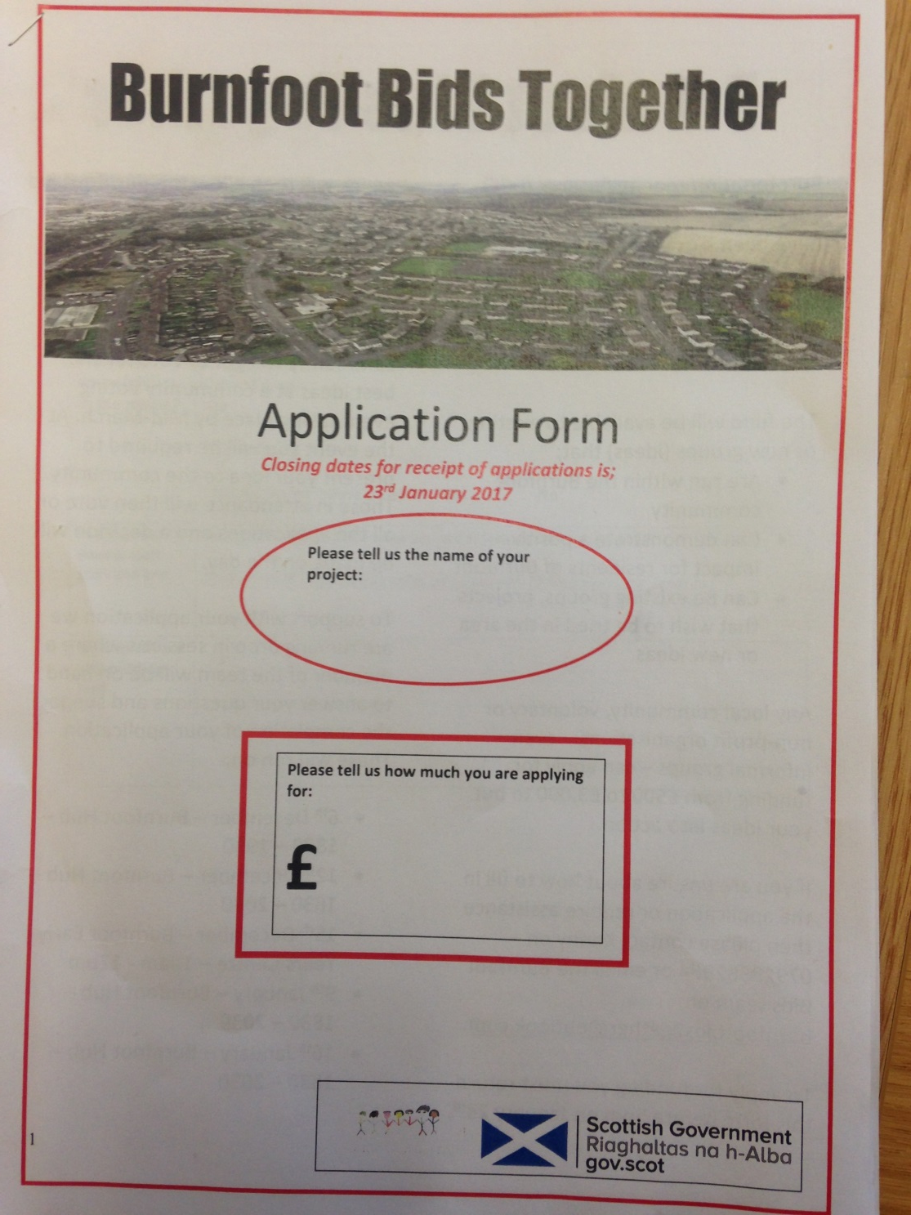
Any questions???

Slide 5
Outline timescales
1st Planning Meeting – 1 November 2016
Application Process/Criteria – November to December
Community Information sessions early late December - Early January – rota (1 event – 2 hours)
Applications to be received by 23rd January 2017
Sorting applications/application queries – last week in January
February onwards– organising voting event
Voting Event Held – Sunday, 19 October 2016

Slide 6
What was achieved
45 groups or organisations applied for a share of the money with 25 applicants being successful and being put forward to the community voting day on 19th March.
300 community votes were counted.
13 Successful Groups.
3 health related projects accessed HLN monies as part of similar process.
2 steering group members have taken up volunteering positions.
3 steering group members have joined Burnfoot Community Futures Board.

